Slide 1
Storage

Slide 2
Team Members
15L-4183 Jahangir Shahid
14L-4401 Hassan Sohail
17L-4102 Usman Zahoor

Slide 3
Introduction
Firebase Storage is built for app developers who need to store and serve user-generated content, such as photos or videos
Cloud Storage for Firebase is a powerful, simple, and cost-effective object storage service built for Google Scale

Slide 4


Benefits of firebase Storage
Strong Security
Robust Operations

Slide 5
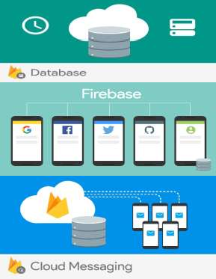

How it Works?
Stores your files in a Google Cloud Storage making them accessible through both Firebase and Cloud
The firebase SDKs for Cloud Storage integrate seamlessly with Firebase Authentication to identify users.
Files can be made private or public as you want

Slide 6

Thank You

